Slide 1
Instance Based Learning

Slide 2
Introduction
Instance-based learning methods simply store the training examples.
Generalizing beyond these examples is postponed until a new instance must be classified.
Instance-based methods are sometimes referred to as "lazy" learning methods because they delay processing until a new instance must be classified.
These methods can estimate target function locally and differently for each new instance to be classified.
One disadvantage of instance-based approaches is that the cost of classifying new instances can be high.

Slide 3
Learning Methods
k-Nearest Neighbor
Locally weighted regression
Radial basis functions
Case-based reasoning
Lazy and eager learning

Slide 4


k-Nearest Neighbor
Assumes all instances correspond to points in the n-dimensional space .
The nearest neighbours of an instance are defined in terms of the standard Euclidean distance.
The following algorithm is for discrete valued target function.

Slide 5
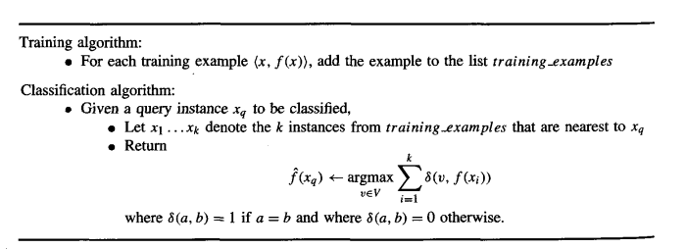
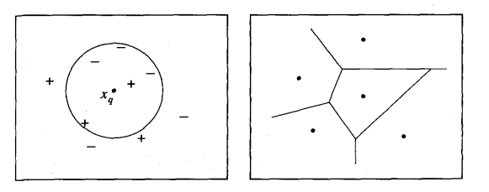

Slide 6

k-Nearest Neighbor
The 1-NEAREST NEIGHBOR algorithm classifies xq, as a positive example in left figure, whereas the 5-NEAREST NEIGHBOR algorithm classifies it as a negative example.
Right side shows the shape of this decision surface induced by 1-NEAREST NEIGHBOR over the entire instance space.
The decision surface is a combination of convex polyhedra surrounding each of the training examples.
Query points outside the polyhedron are closer to some other training example.
This kind of diagram is often called the Voronoi diagram of the set of training examples.
The k-NEAREST NEIGHBOR algorithm is easily adapted to approximating continuous-valued target functions.

Slide 7



k-Nearest Neighbor
Distance-Weighted NEAREST NEIGHBOR Algorithm
weight the contribution of each of the k neighbors according to their distance to the query point xq.
For discrete valued
For continuous valued

Slide 8
k-Nearest Neighbor
Remarks on k-NEAREST NEIGHBOR Algorithm
Highly effective inductive inference method for many practical problems.
It is robust to noisy training data and quite effective on large set of training data.
The inductive bias corresponds to an assumption that the classification of an instance xq, will be most similar to the classification of other instances that are nearby in Euclidean distance .
Nearest-neighbor approaches are especially sensitive to curse of dimensionality.
To overcoming this problem is to weight each attribute differently when calculating the distance between two instances or completely eliminate the least relevant attributes from the instance space.
To reduce the computation use memory indexing methods. Ex:kd-tree.

Slide 9
Terminology
Regression means approximating a real-valued target function.
Residual is the error { f’( x ) - f ( x ) in approximating the target function. Kernel function is the function of distance that is used to determine the weight of each training example.
In other words, the kernel function is the function K such that wi = K(d(xi,xq)).

Slide 10
LOCALLY WEIGHTED REGRESSION
The nearest-neighbor approaches described in the previous section can be thought of as approximating the target function f ( x ) at the single query point x = xq.
Locally weighted regression uses nearby or distance-weighted training examples to form local approximation to f.
Locally weighted regression is called local because the function is approximated based only on data near the query point, weighted because the contribution of each training example is weighted by its distance from the query point, and regression for the problem of approximating real-valued functions.
Given a new query instance xq,the general approach in locally weighted regression is to construct an approximation f^ that fits the training examples in the neighborhood surrounding xq.

Slide 11

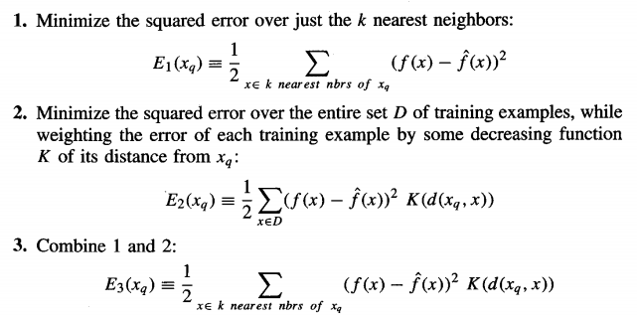
LOCALLY WEIGHTED REGRESSION
The linear function is of the following form
The simple way is to redefine the error criterion E to emphasize fitting the local training examples is as follows.

Slide 12

LOCALLY WEIGHTED REGRESSION
Criterion three is a good approximation to criterion two and has the advantage that computational cost is independent of the total number of training examples .
Re derive the gradient descent rule as follows
In most cases, the target function is approximated by a constant, linear, or quadratic function.
More complex functional forms are not often found because
the costof fitting more complex functions for each query instance is prohibitively high
these simple approximations model the target function quite well

Slide 13


RADIAL BASIS FUNCTIONS
One approach to function approximation that is closely related to distance-weighted regression and also to artificial neural networks is learning with radial basis functions .
The learned hypothesis is a function of the form .
Here k is a user provided constant that specifies the number of kernel functions to be included .

Slide 14
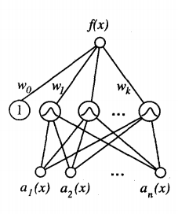
RADIAL BASIS FUNCTIONS
It can be viewed asas describing a two layer network where the first layer of units computes the values of the various Ku(d(xu, x ) ) and where the second layer computes a linear combination of these first-layer unit values.

Slide 15
RADIAL BASIS FUNCTIONS
Given a set of training examples of the target function, RBF networks are typically trained in a two-stage process.
The number k of hidden units is determined and each hidden unit u is defined by choosing the values of xu and σ_{u}² .
The weights w_{u} are trained to maximize the fit of the network to the training data, using the global error criterion .
Approaches for choosing k
Allocate a Gaussian kernel function for each training example. The advantage is it allows the RBF network to fit the training data exactly.

Slide 16
RADIAL BASIS FUNCTIONS
To choose a set of kernel functions that is smaller than the number of training examples.
This approach is much more efficient especially when the number of training examples is large.
The set of kernel functions may be distributed with centers spaced uniformly throughout the instance space X or non uniformly over X.
For the later case pick the kernel functions by randomly selecting a subset of the training instances .
Also we may identify prototypical clusters of instances, then add a kernel function centered at each cluster.

Slide 17
RADIAL BASIS FUNCTIONS
The placement of the kernel functions in this fashion can be accomplished using unsupervised clustering algorithms that fit the training instance s.
Radial basis function networks provide a global approximation to the target function, represented by a linear combination of many local kernel functions.
One key advantage to RBF networks is that they can be trained much more efficiently than feed forward networks trained with BACKPROPAGATION.

Slide 18
CASE-BASED REASONING
Case-based reasoning (CBR) is a learning paradigm based on the following principles
The decision of how to generalize beyond the training data until a new query instance is observed .
Classify new query instances by analyzing similar instances .
Instances are typically represented using more rich symbolic descriptions, and the methods used to retrieve similar instances are correspondingly more elaborate.
Applied to problems such as conceptual design of mechanical devices based on a stored library of previous designs.

Slide 19
CASE-BASED REASONING
Example:CADET system for conceptual design of simple mechanical devices such as water faucets .
It uses a library containing approximately 75 previous designs and design fragments to suggest conceptual designs to meet the specifications of new design problems.
Each instance stored in memory is represented by describing both its structure and its qualitative function.
New design problems are then presented by specifying the desired function and requesting the corresponding structure.

Slide 20
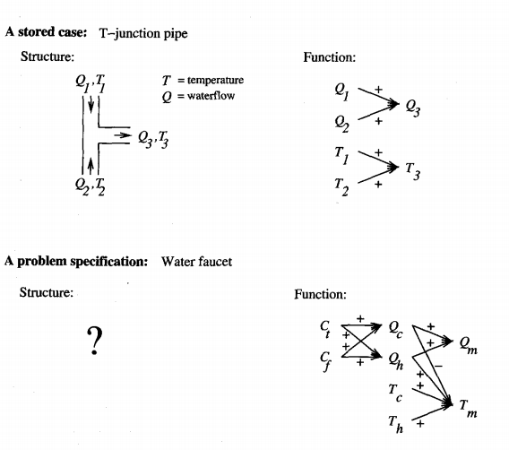

Slide 21
CASE-BASED REASONING
Given the functional specification for the new design problem, CADET searches its library for stored cases whose functional descriptions match the design problem.
If an exact match is found, indicating that some stored case implements exactly the desired function, then this case can be returned as a suggested solution to the design problem.
If no exact match occurs, CADET may find cases that match various subgraphs of the desired functional specification.
CADET searches for subgraph isomorphisms between the two function graphs, so that parts of a case can be found to match parts of the design specification

Slide 22

CASE-BASED REASONING
The system may also elaborate the original function specification graph in order to create functionally equivalent graphs that may match still more cases .
By retrieving multiple cases that match different subgraphs, the entire design can sometimes be pieced together.
CADET has very limited capabilities for combining and adapting multiple retrieved cases to form the final design and relies heavily on the user for this adaptation stage of the process.

Slide 23
CASE-BASED REASONING
Standard Notation:
The target function f maps function graphs to the structures that implement them.
Each stored training example (x,f (x)) is a pair that describes some function graph x and the structure f ( x ) that implements x
The system must learn from the training example cases to output the structure f (x,) that successfully implements the input function graph query xq.

Slide 24
CASE-BASED REASONING
General properties
Instances or cases may be represented by rich symbolic descriptions.
Multiple retrieved cases may be combined to form the solution to the new problem.
There may be a tight coupling between case retrieval, knowledge-based reasoning, and problem solving .
The current research issue in case-based reasoning is to develop improved methods for indexing cases.

Slide 25
CASE-BASED REASONING
The multiple retrieved design fragments may turn out to be incompatible with one another, making it impossible to combine them into a consistent final design.
Then the CBR system may backtrack and search for additional cases, adapt the existing cases, or resort to other problem-solving methods.
They also provide training data for improving the similarity metric or, equivalently, the indexing structure for the case library.
Ex:case is retrieved, found to be irrelevant then the similarity metric should be refined to reject this case for similar subsequent queries.

